Slide 1
Stream ThousandEyes Data to Splunk Using OpenTelemetry
DEVWKS-2656
Antonio Jimenez
Tech Lead Software Engineer @ajimenez1503
Session ID: DEVWKS-2656
Notes:
Welcome to my session.
I would like to start with a question. Have you heard about ThounsandEyes/Splunk/OpenTelemetry? You are lucky
Today, we are going to learn how to stream ThousandEyes data to Splunk using OpenTelemetry

Slide 2
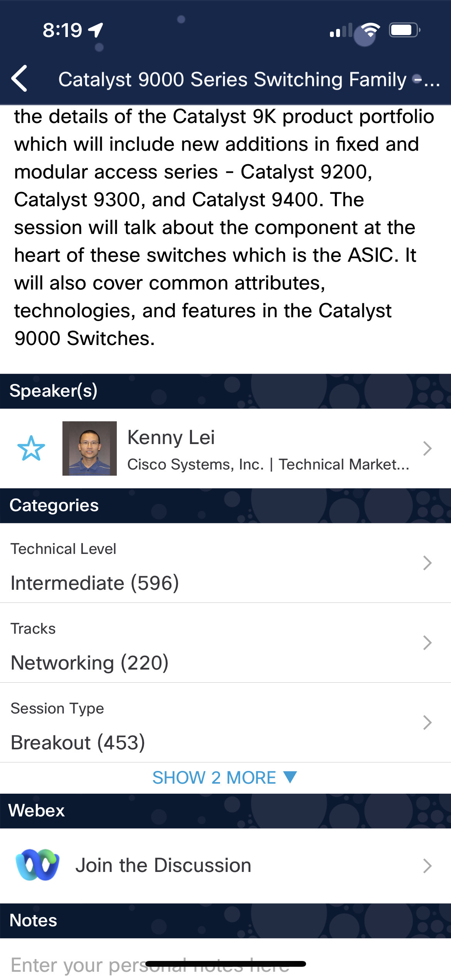
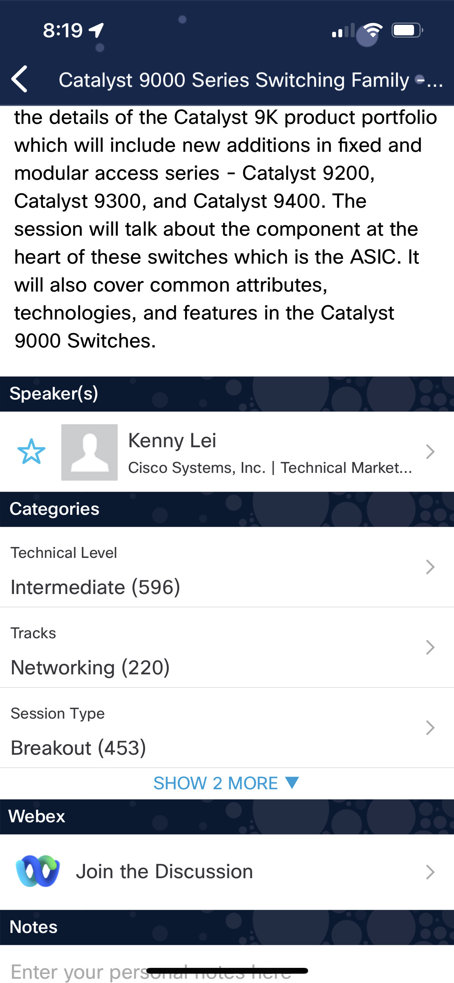

Cisco Webex App
Questions?
Use Cisco Webex App to chat with the speaker after the session
How
1
Find this session in the Cisco Live Mobile App
Click “Join the Discussion”
Install the Webex App or go directly to the Webex space
Enter messages/questions in the Webex space
2
3
4
Enter your personal notes here
Webex spaces will be moderated by the speaker until June 13, 2025.
https://ciscolive.ciscoevents.com/ ciscolivebot/#BRKXXX-xxxx
Notes:
As you know there is a channel for all the session during all Cisco Live.
Feel free to make any question, I will be more than happy to answer.

Slide 3

Detect Outages Instantly with ThousandEyes
Notes:
Could you imagine detecting a outages from hours to minutes?
Changing from screaming customers to proactive solutions?
Our key message is to detect outages instantaneously using ThousandEyes.
That is why we are all here. Send ThousandEyes network data to Splunk and detect the issues quickly.

Slide 4

Agenda
Introduction
OpenTelemetry
ThousandEyes
Splunk
Workshop
ThousandEyes
Splunk Observability Cloud
Splunk Enterprise
ThousandEyes App for Splunk
Notes:
Agenda
Goal
The goal of the talk is that you understand how easy is to stream ThousandEyes telemetry data to any observability backend
Time to meet the speaker:
I am Antonio Jimenez
Working on Cisco ThousandEyes during the last 2 years
Focus on Observability and OpenTelemetry during the last 4 years
In my free time I love traveling and running tech meetup

Slide 5
Introduction

Slide 6
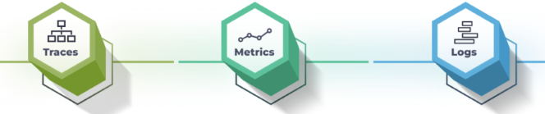
OpenTelemetry (OTel)
Open-source observability framework
Collection of tools, APIs, and SDKs
Management of telemetry data
Instrument, generate, collect, and export
Notes:
- Cloud Native Computing Foundation (CNCF) - Vendor agnostic

Slide 7
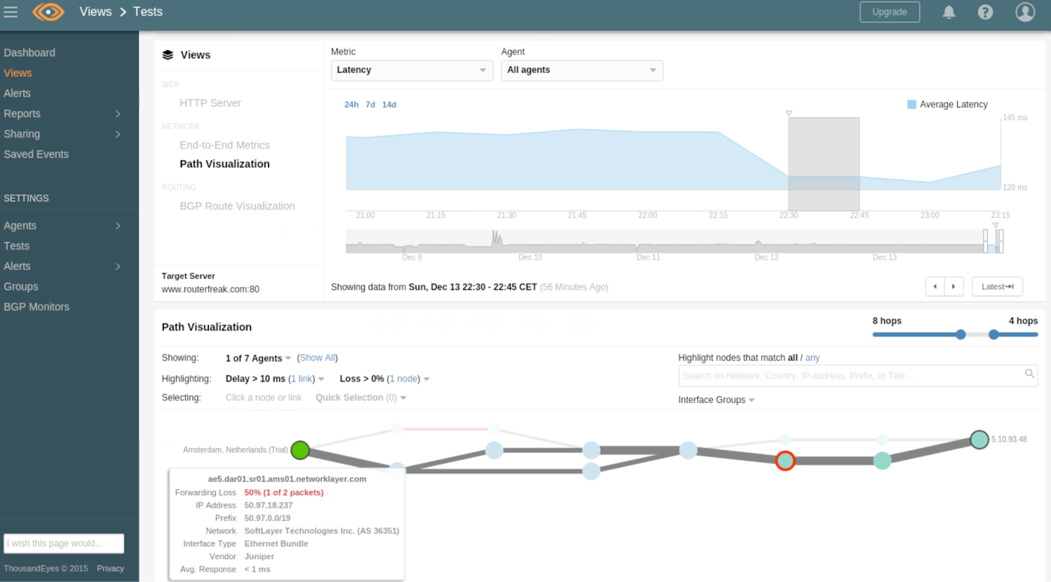
ThousandEyes Network Test
Periodically
Metrics collected: latency, page load time, throughput...
~30k data points/sec

Slide 8

Have you used Splunk before? If so, which product(s)?
Join at
slido.com
# 3469654

Slide 9

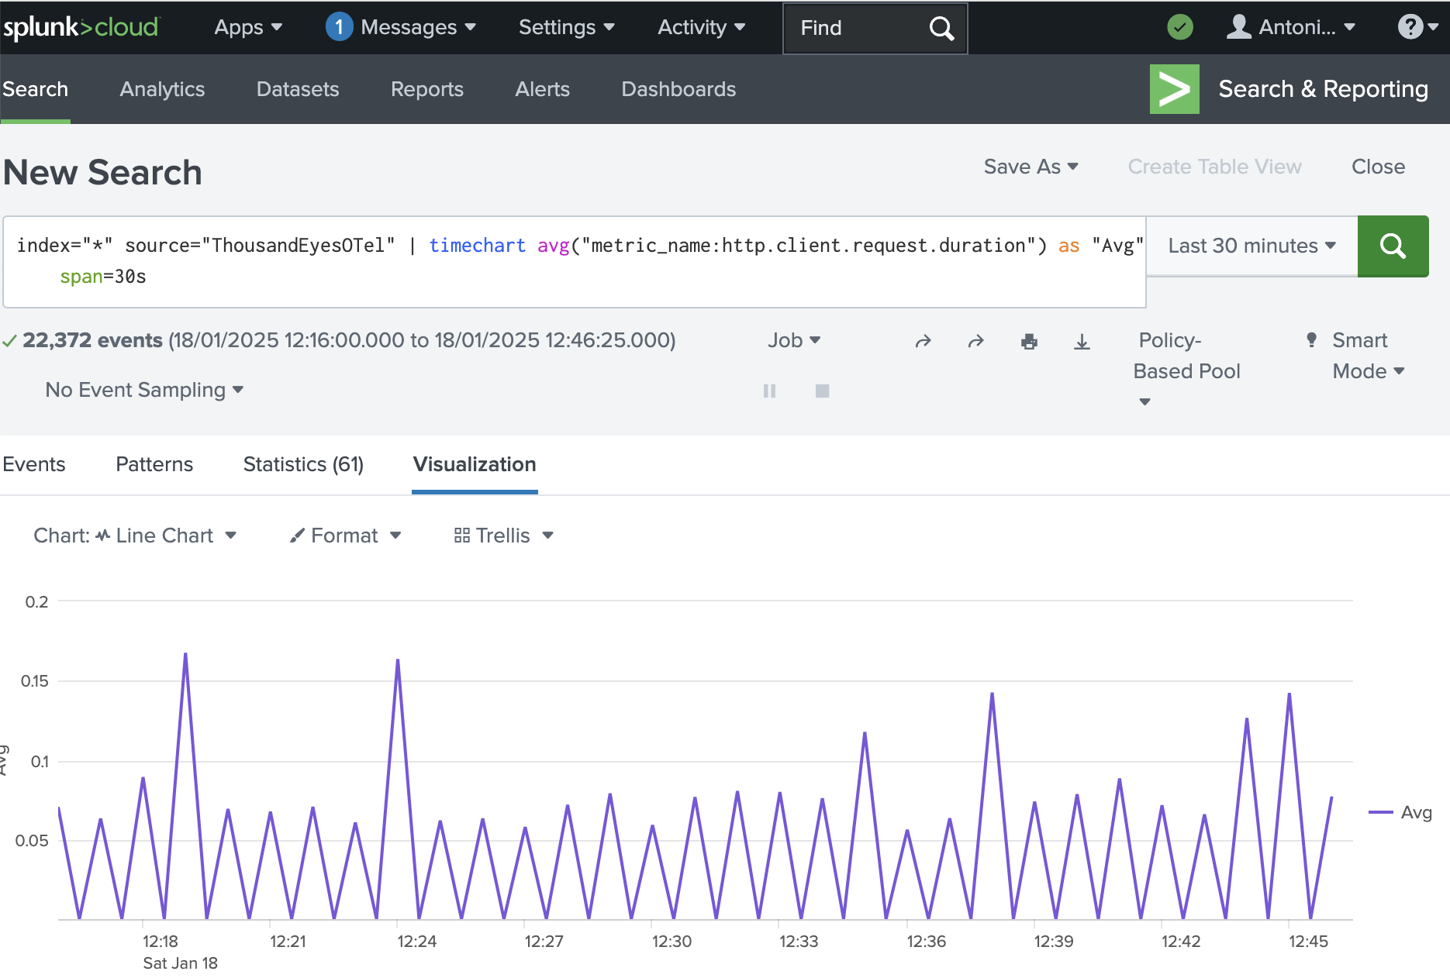
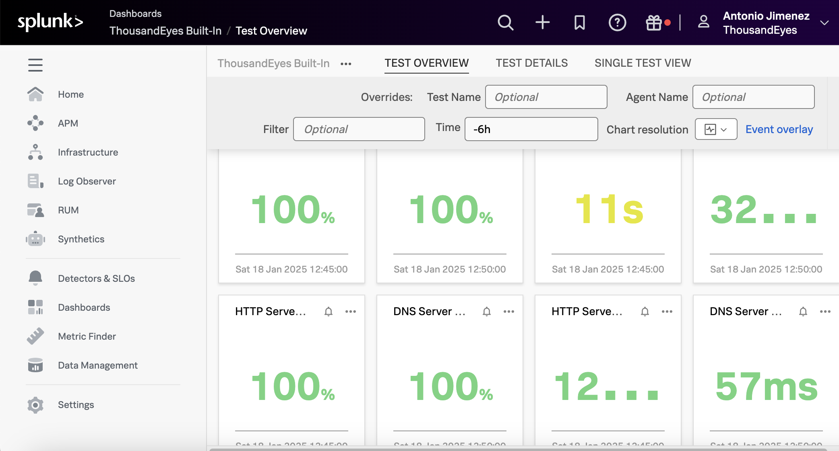
Splunk products
Splunk Enterprise & Splunk Cloud Platform
IT operations, security and business analytics
Highly customizable
Splunk Observability Cloud
Real-time application observability
APM (Application Performance Monitoring)
RUM (Real User Monitoring)

Slide 10
Workshop

Slide 11


Splunk Enterprise
Splunk Observability Cloud

Slide 12
Login – User & Password
Email
antonjim+devnet<seat>@cisco.com
e.g. antonjim+devnet1@cisco.com
Password:
Cisco.25

Slide 13
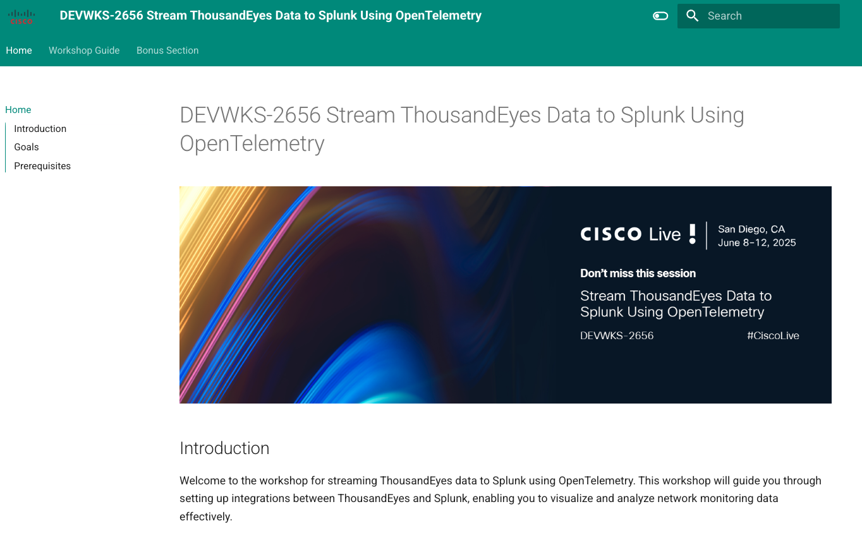

Slide 14
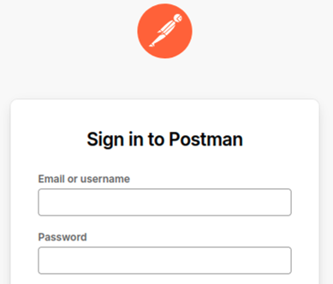
Step 1. Access Postman
Sign in Postman
Email
antonjim+devnet<seat>@cisco.com
e.g. antonjim+devnet1@cisco.com
Password:
Cisco.25

Slide 15
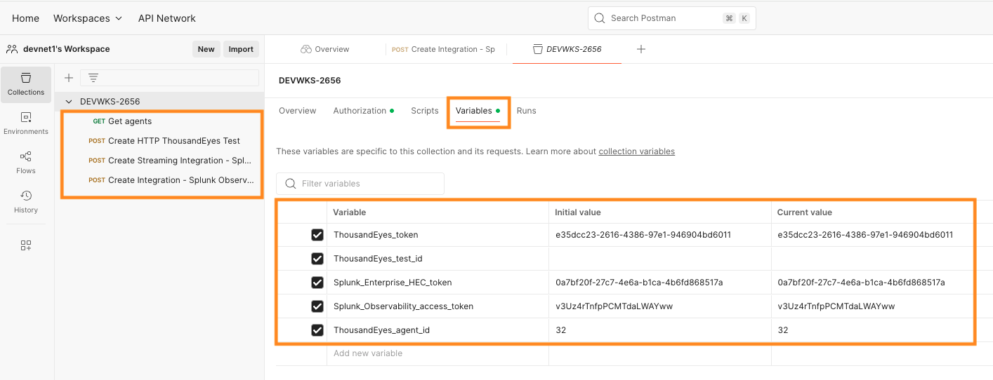
Step 1. Verify Postman collection DEVWKS-2656
Notes:
Navigate to Workspaces -> devnet’s Workspace
Identify the collection DEVWKS-2656Confirm the requests and variables are there.
We will use them during the session.

Slide 16
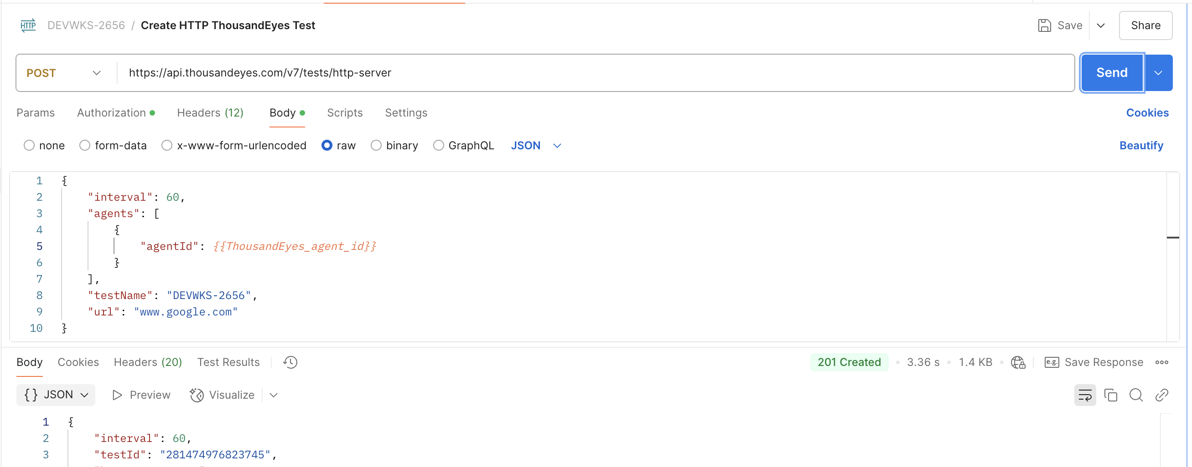
Step 2. Create ThousandEyes HTTP Server test
Notes:
Create an HTTP Server test that validates www.google.com

Slide 17
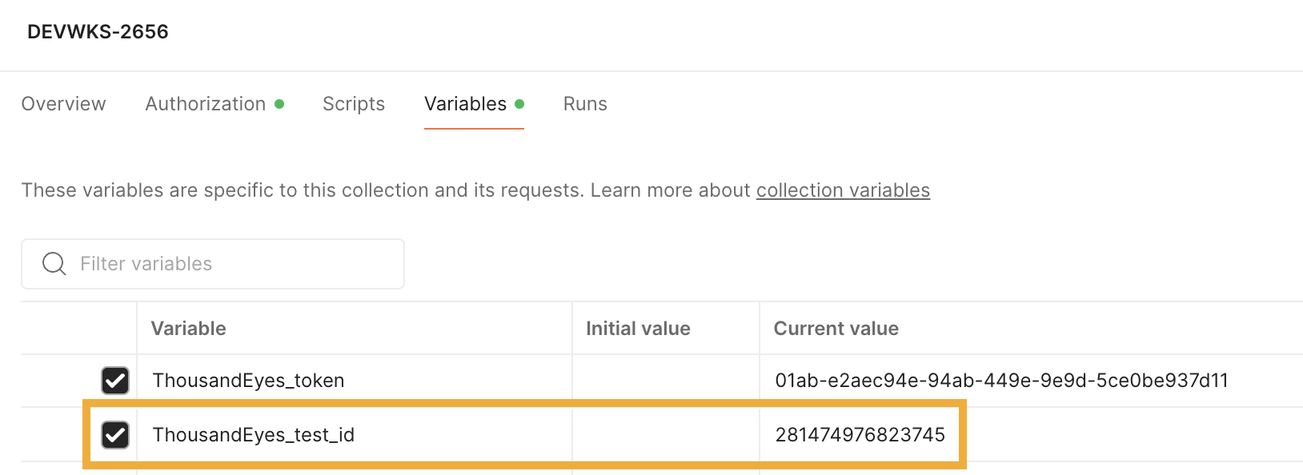
Step 2. Create ThousandEyes HTTP Server test
Save the testId into the variable ThousandEyes_test_id in Postman

Slide 18
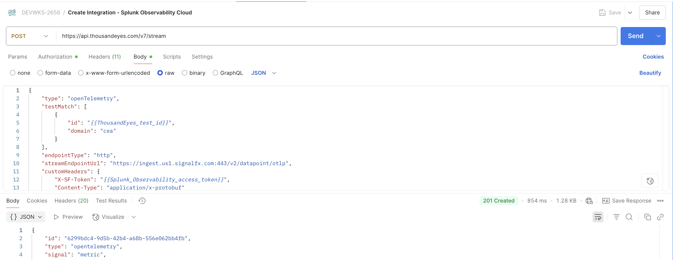
Step 3.a. Create integration for Splunk Observability

Slide 19
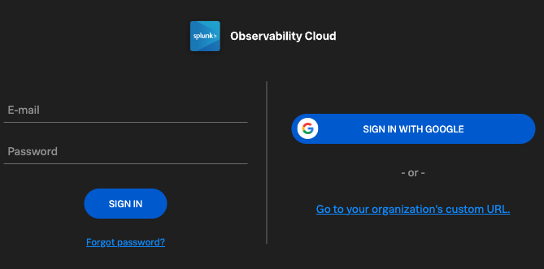
Step 3.b. Access Splunk Observability Cloud
Navigate to Splunk Observability Cloud
Email
antonjim+devnet<seat>@cisco.com
e.g. antonjim+devnet1@cisco.com
Password:
Cisco.25

Slide 20
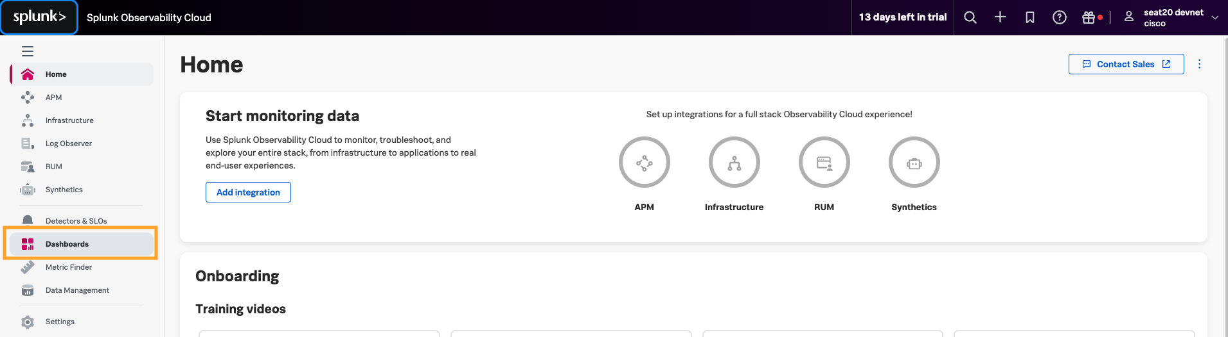
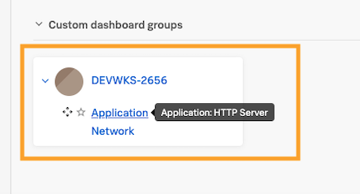
Step 3.c. Visualize data in Splunk Observability cloud
In the initial page
Navigate to Dashboards
Expand DEVWKS-2656
Select Application

Slide 21
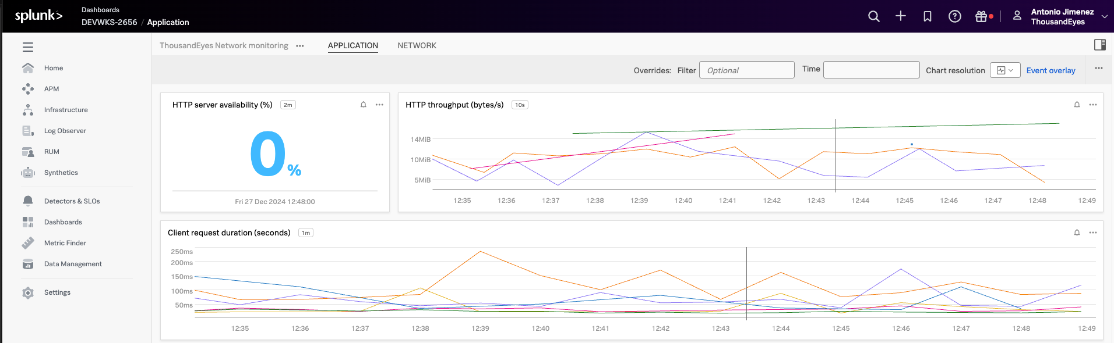
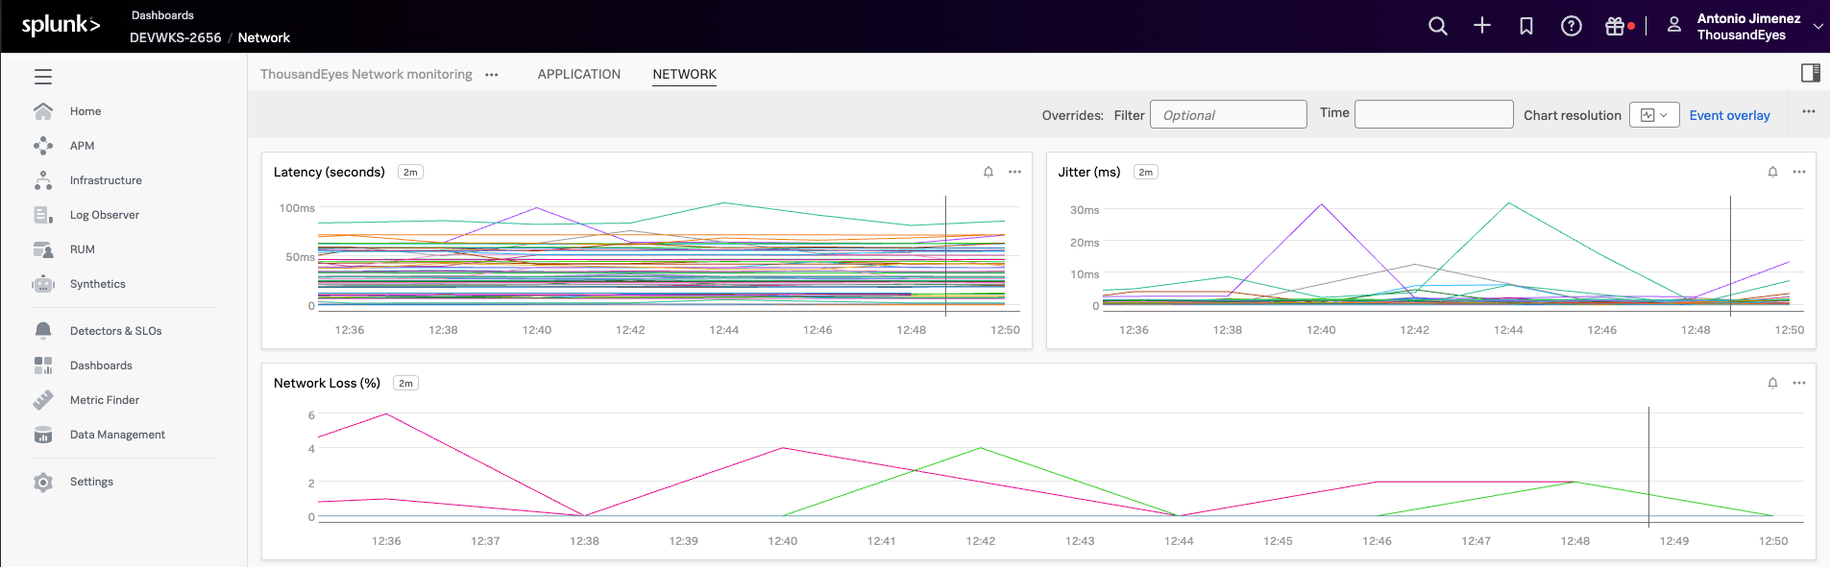
Step 3.c. Visualize data in Splunk Observability cloud

Slide 22
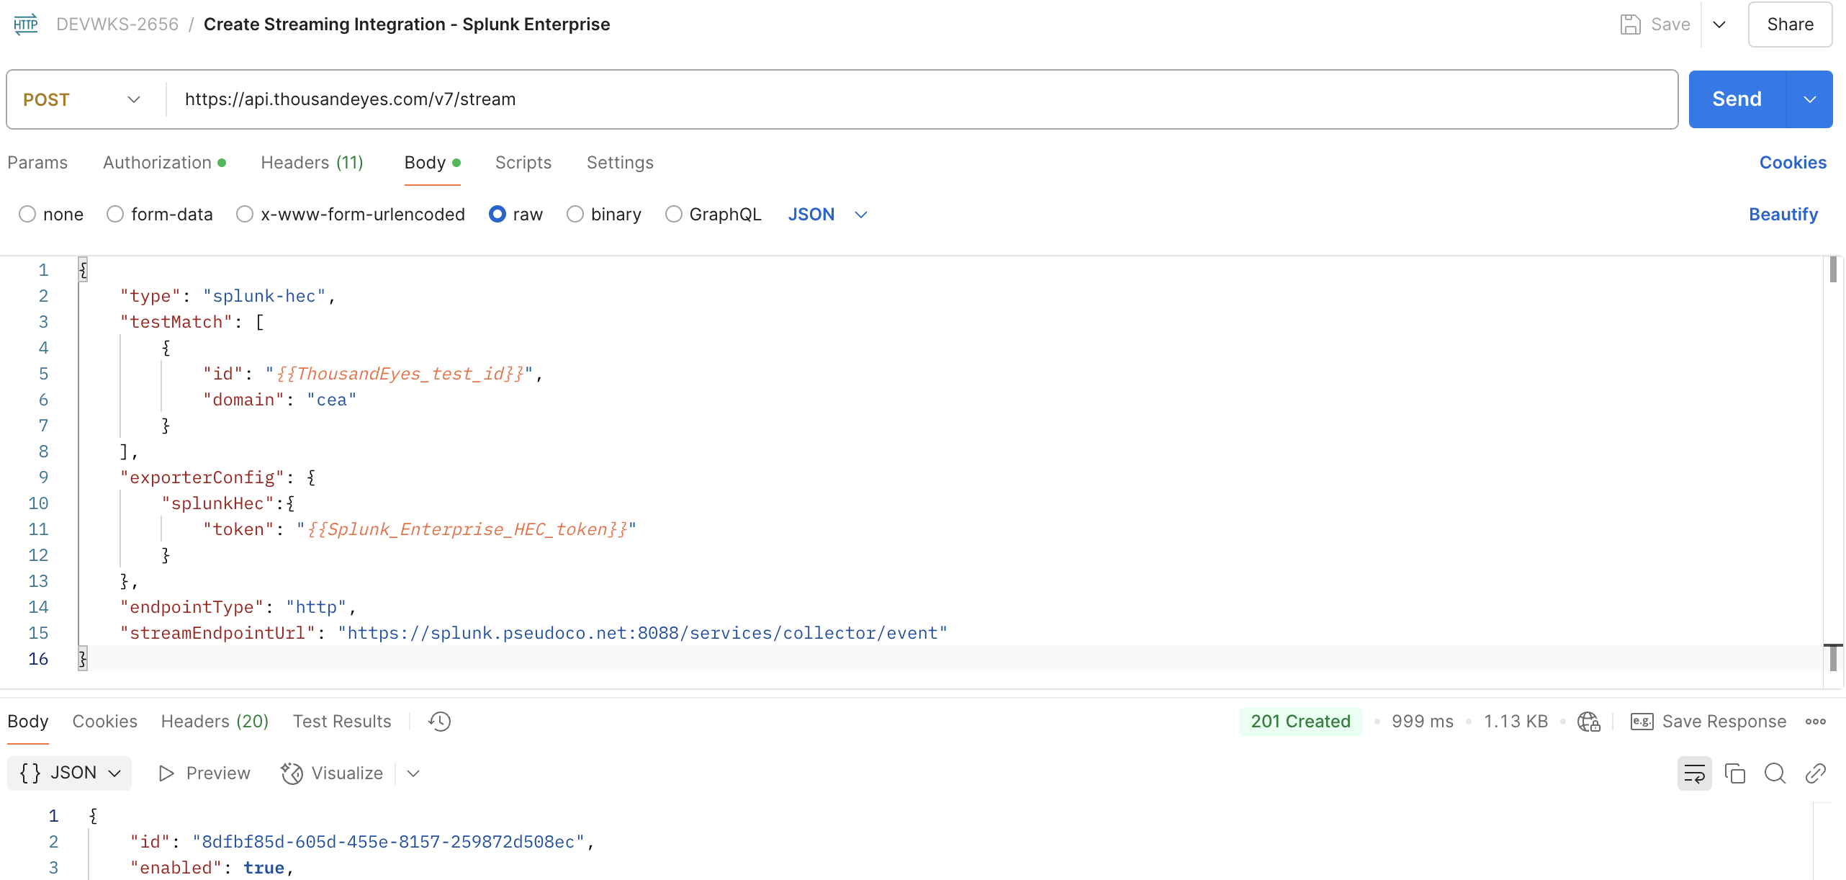
Step 4.a. Create integration for Splunk Enterprise

Slide 23
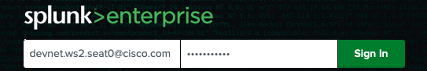
Step 4.b. Access Splunk Enterprise
Navigate to Splunk Enterprise
Email
antonjim+devnet<seat>@cisco.com
e.g. antonjim+devnet1@cisco.com
Password:
Cisco.25

Slide 24
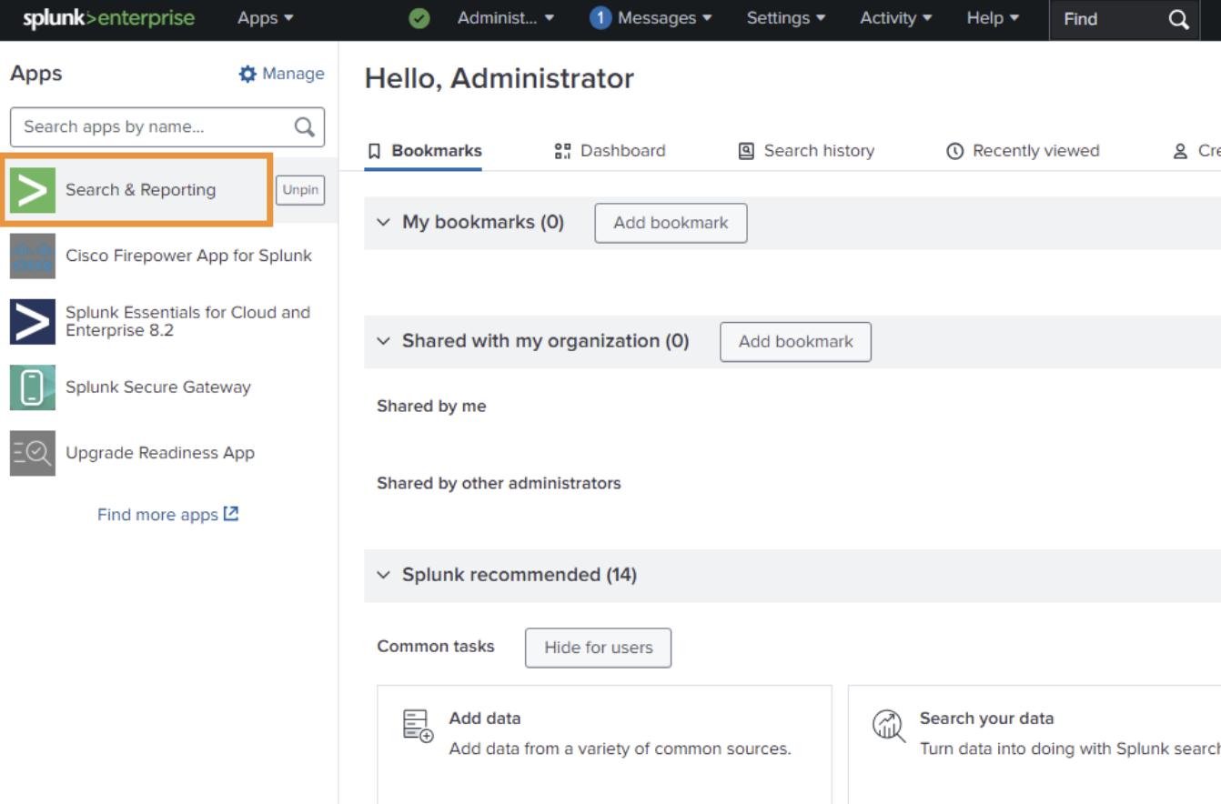
Step 4.c Visualize data in Splunk Enterprise
In the initial page
Navigate to Search & Reporting

Slide 25
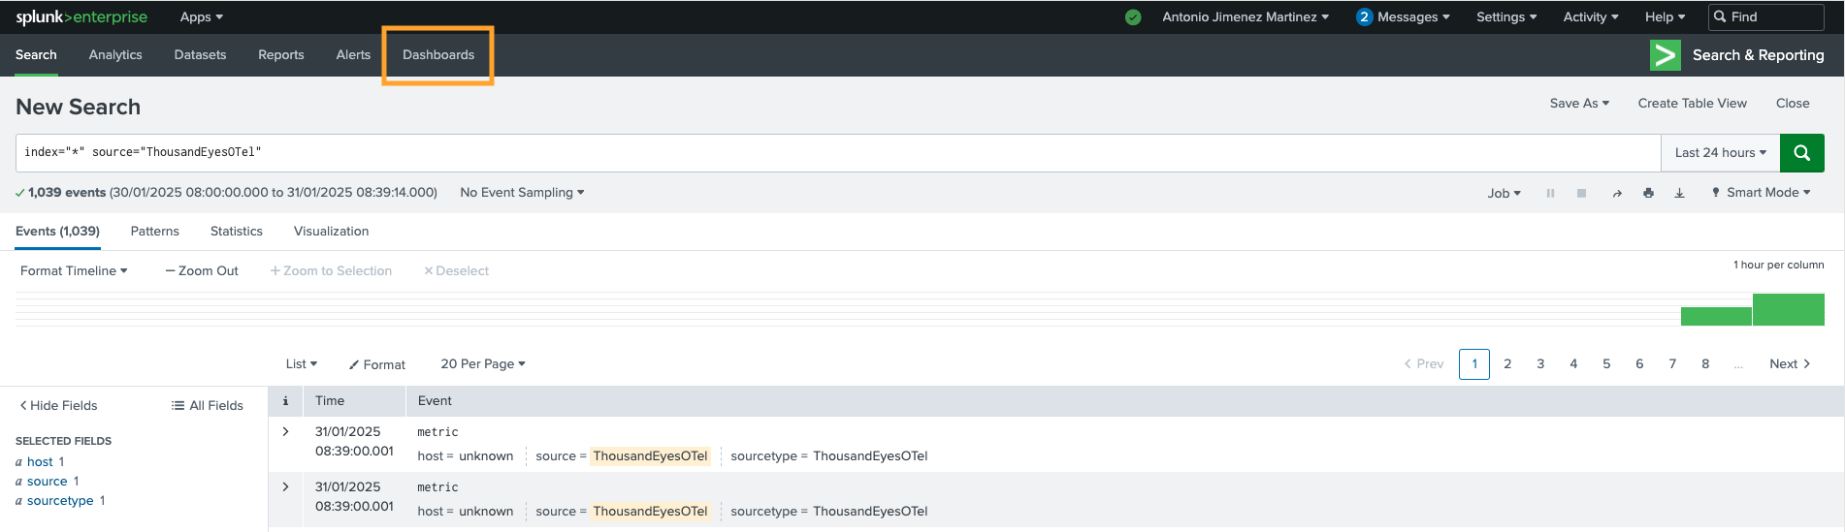
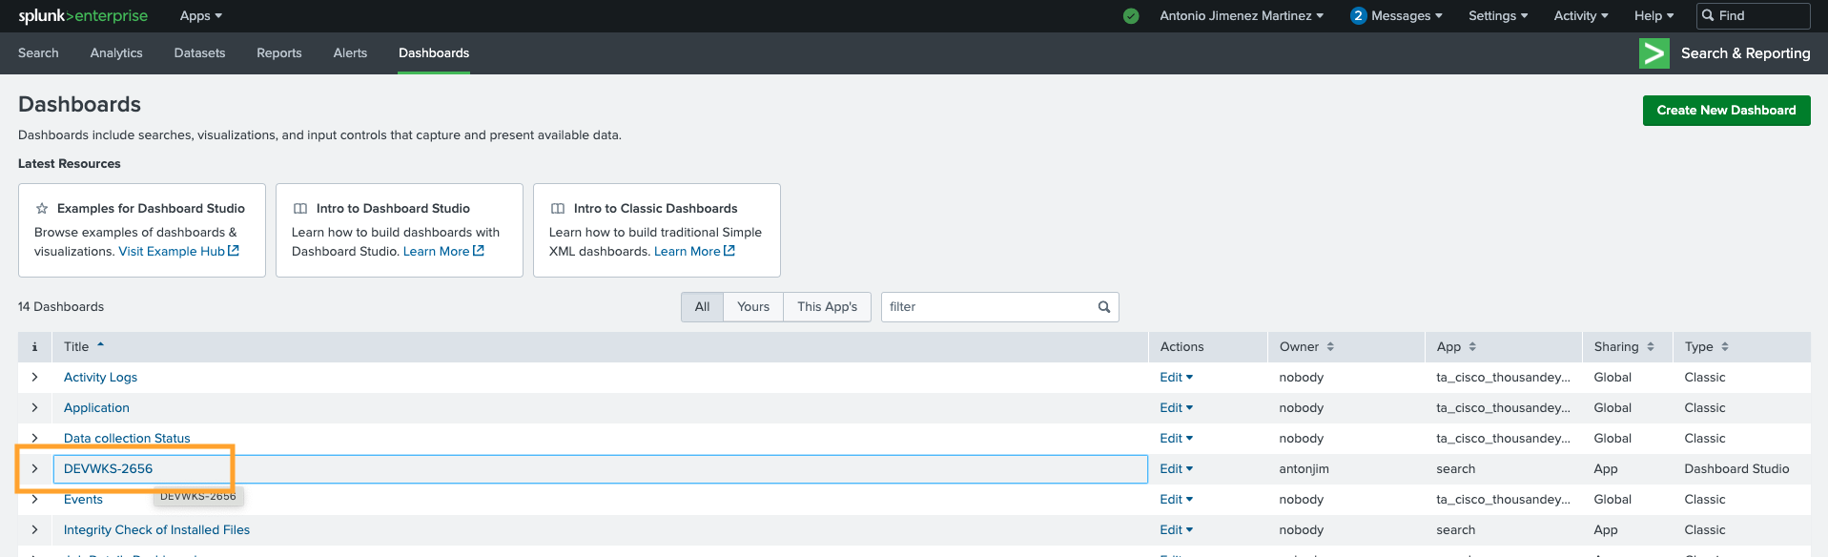
Step 4.c. Visualize data in Splunk Enterprise
Navigate to Dashboards
Select DEVWKS-2656

Slide 26
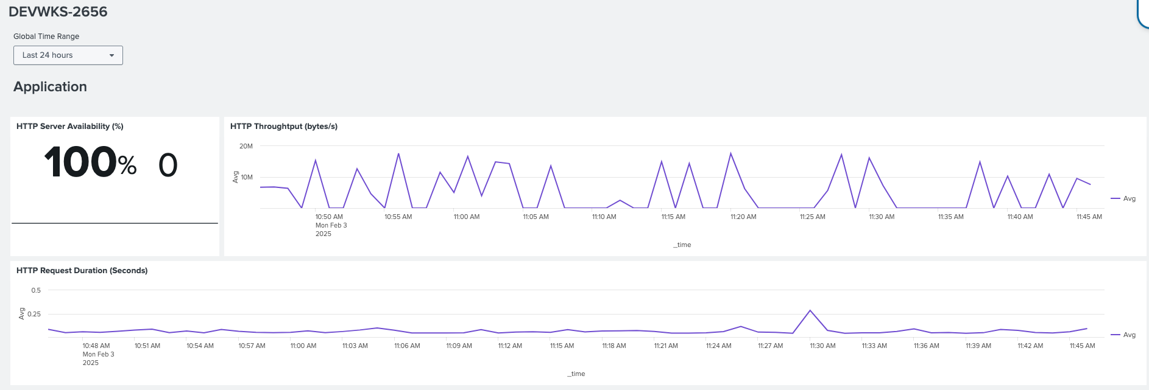
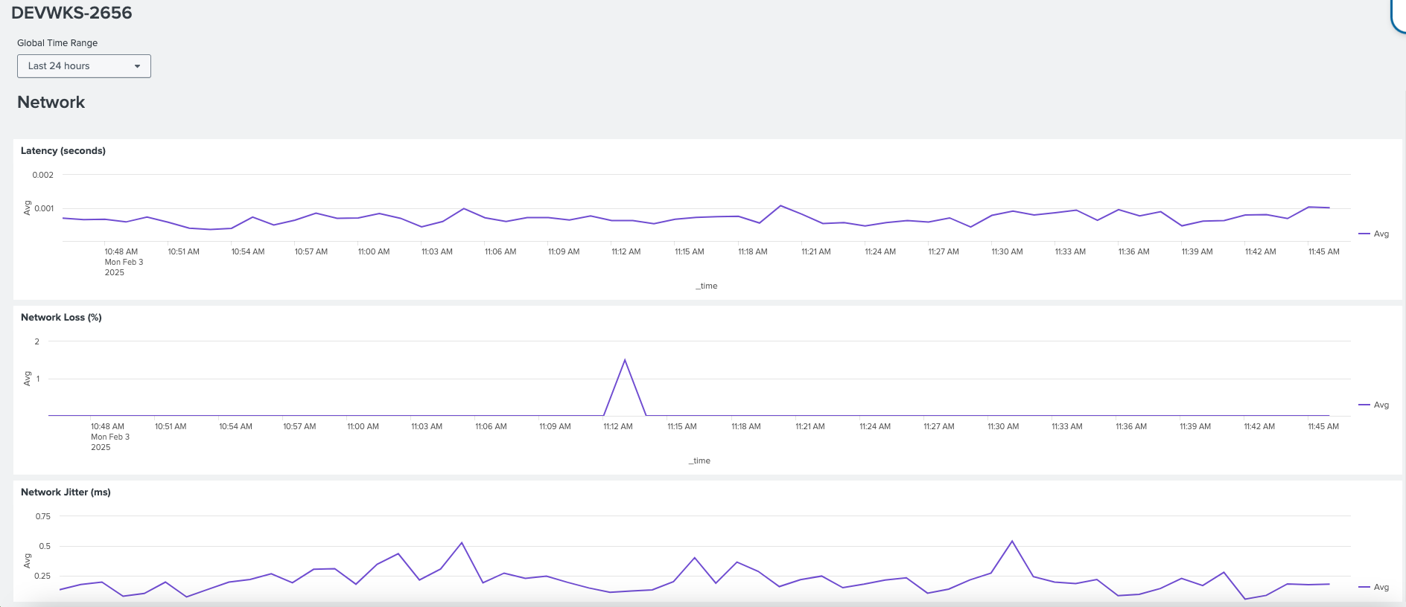
Step 4.c Visualize data in Splunk Enterprise

Slide 27
Workshop – Bonus Section ThousandEyes App for Splunk

Slide 28
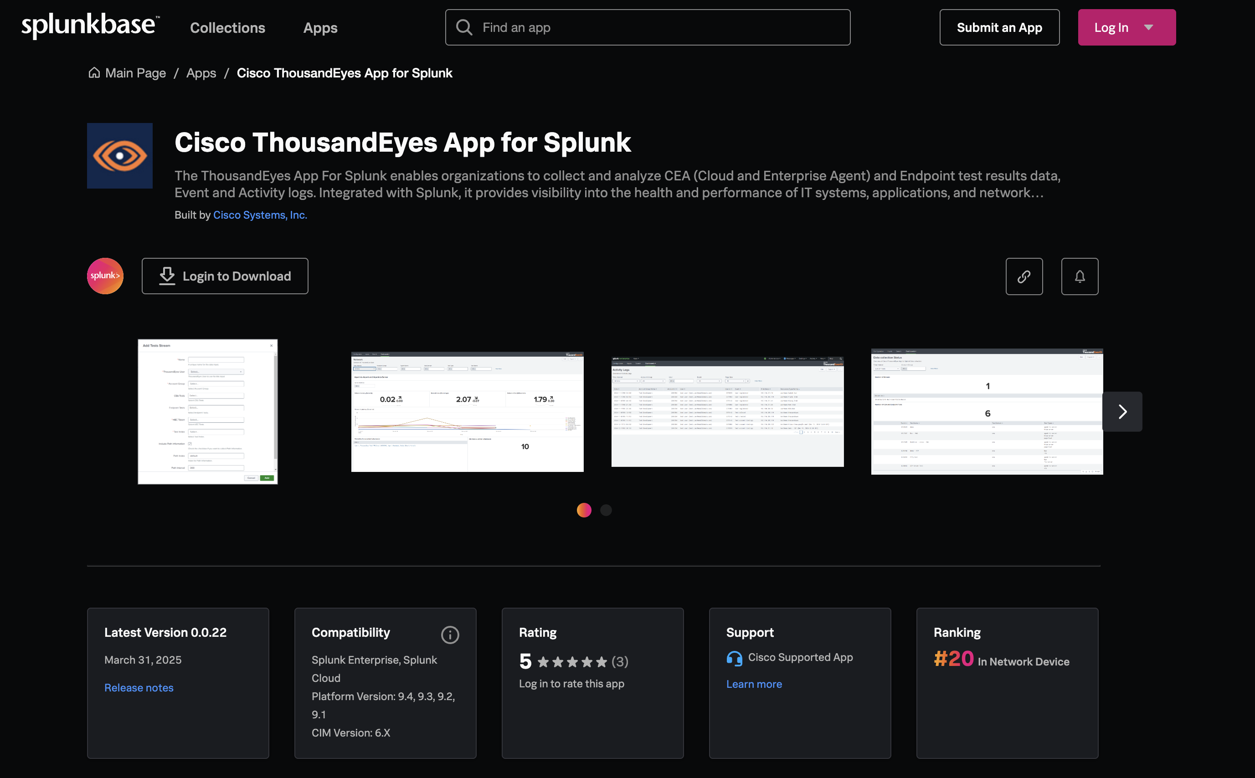
Cisco ThousandEyes App for Splunk
Notes:
The [Cisco ThousandEyes App for Splunk](https://splunkbase.splunk.com/app/7719) enables collectos and analyze:
- CEA (Cloud and Enterprise Agent) and Endpoint test results data
- Event and
- Activity logs

Slide 29
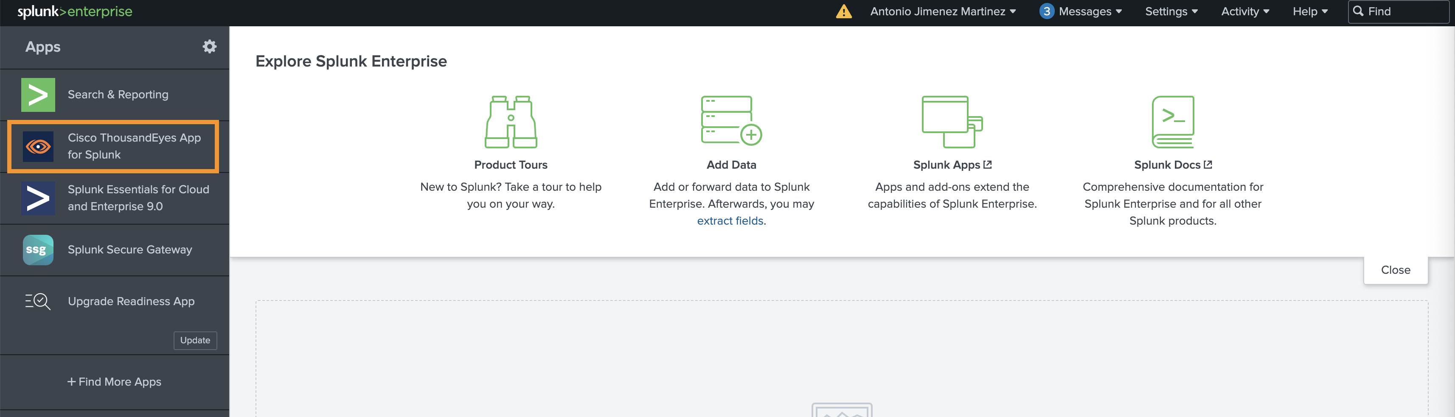
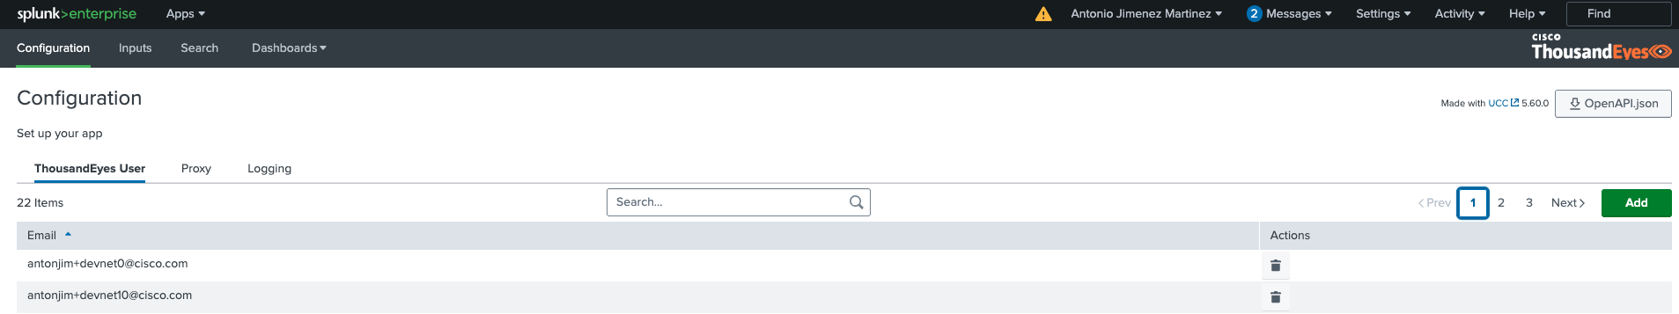
Step 1. Navigate to Cisco ThousandEyes App for Splunk

Slide 30
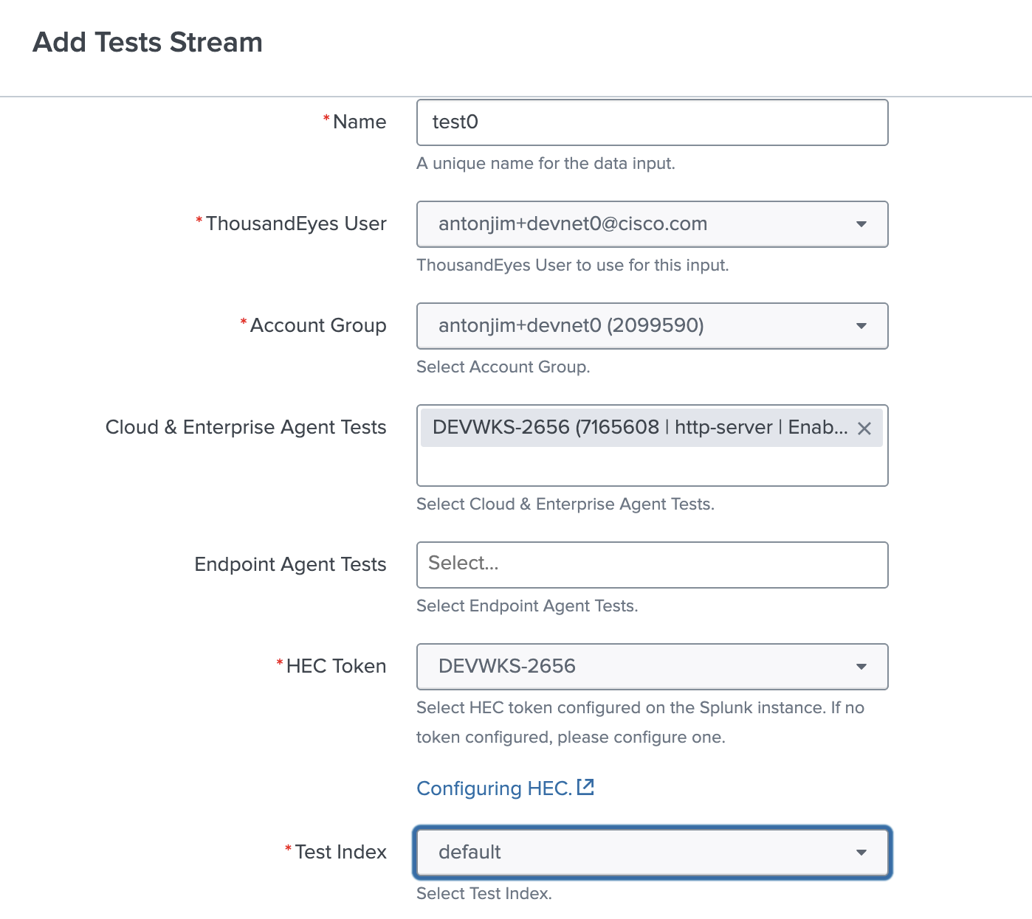
Step 2. Create stream test input
Notes:
- Todo: screenshot

Slide 31
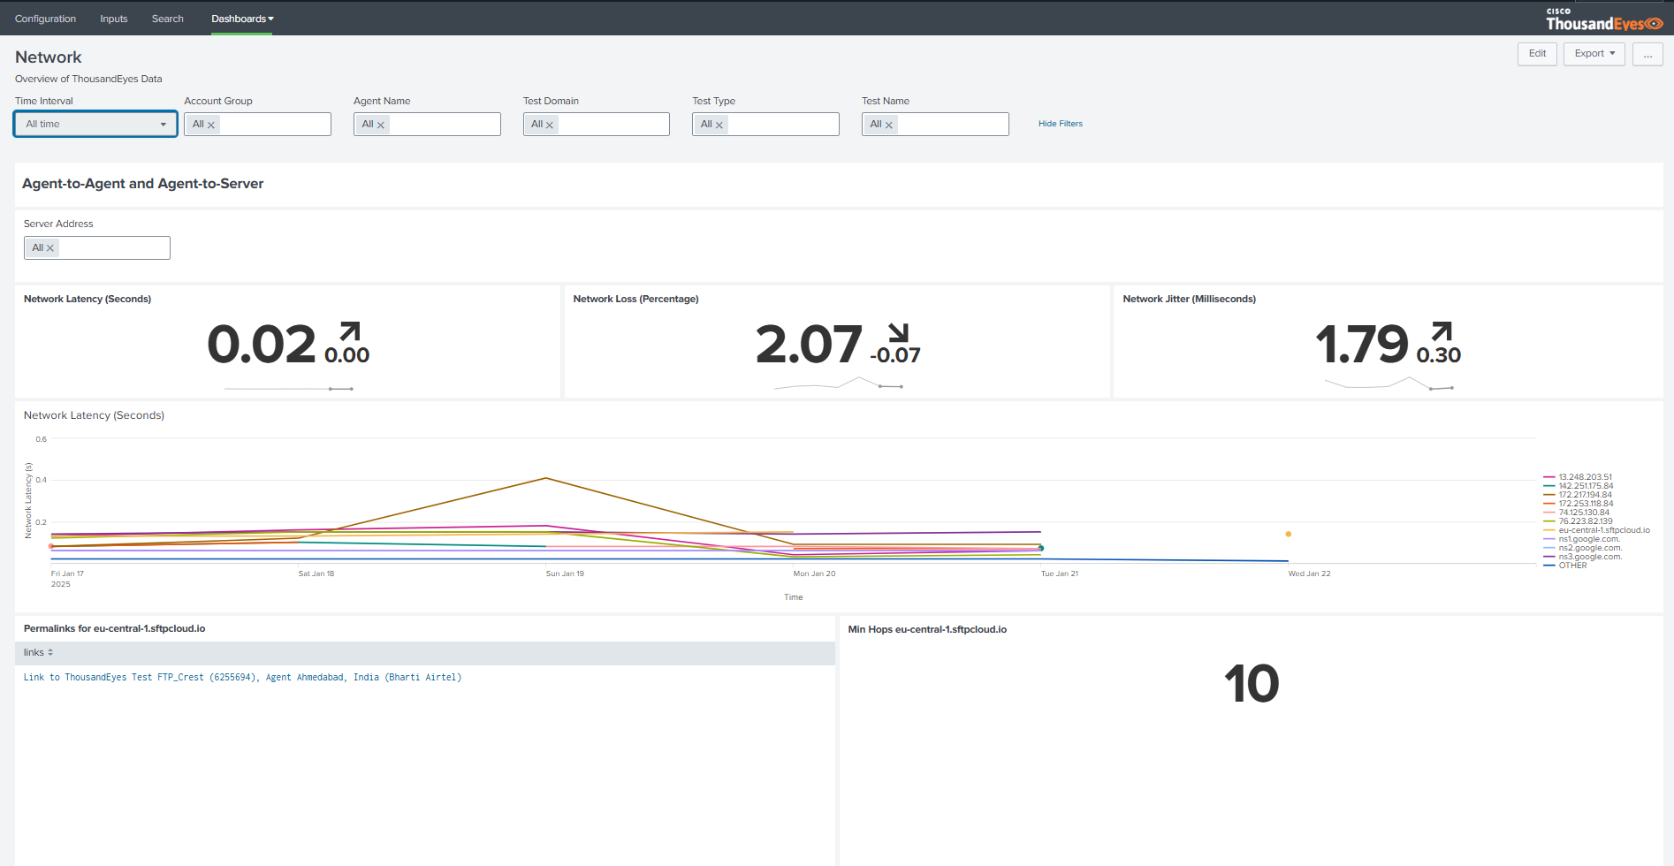
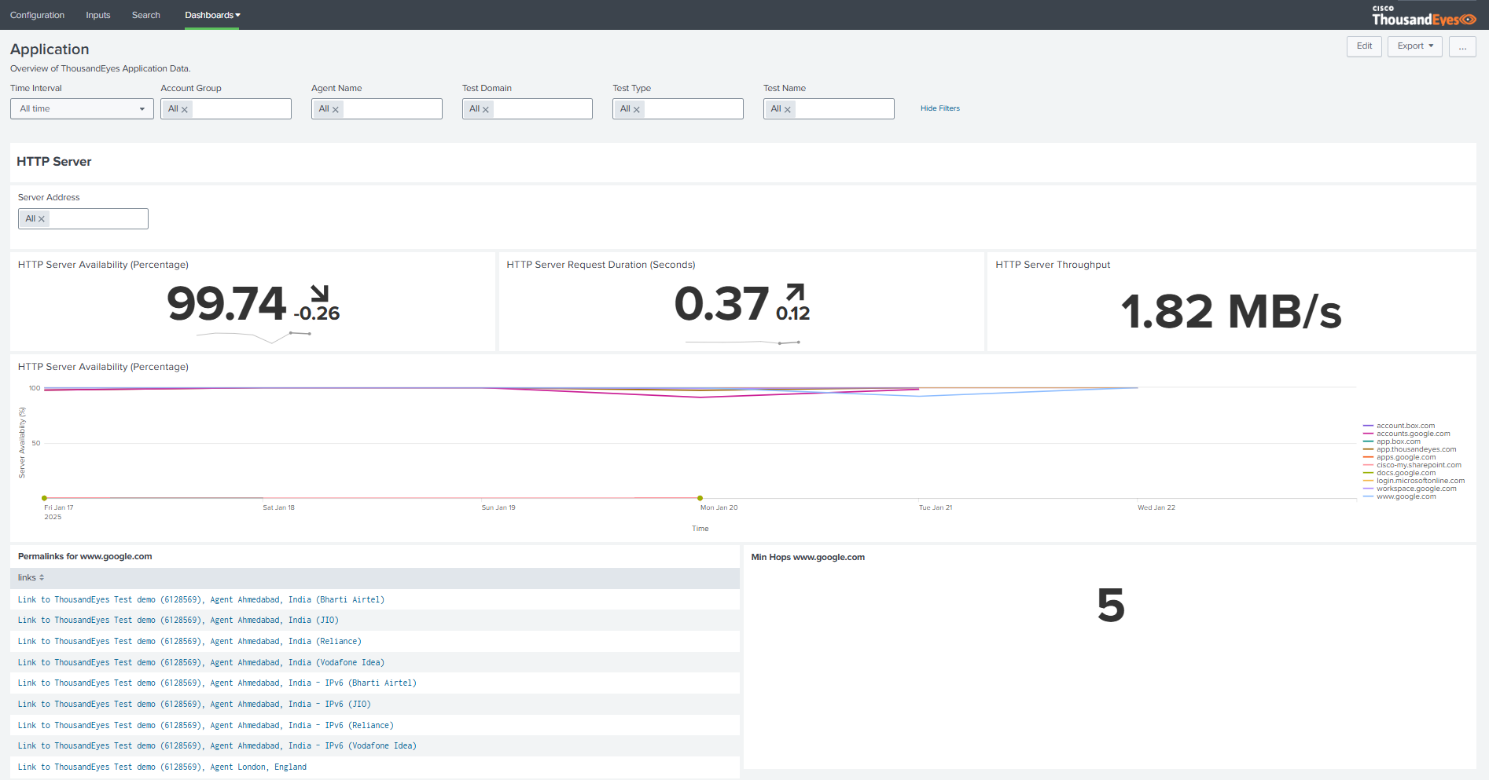
Step 3. Network and Application dashboards
Notes:
- Todo: screenshot

Slide 32
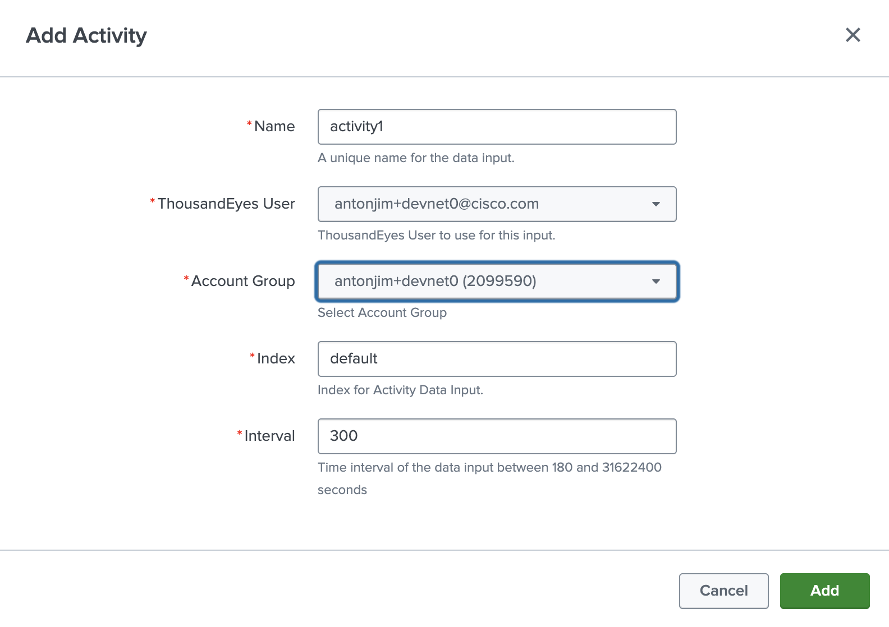
Step 4. Create activity log input
Notes:
- Todo: screenshot

Slide 33
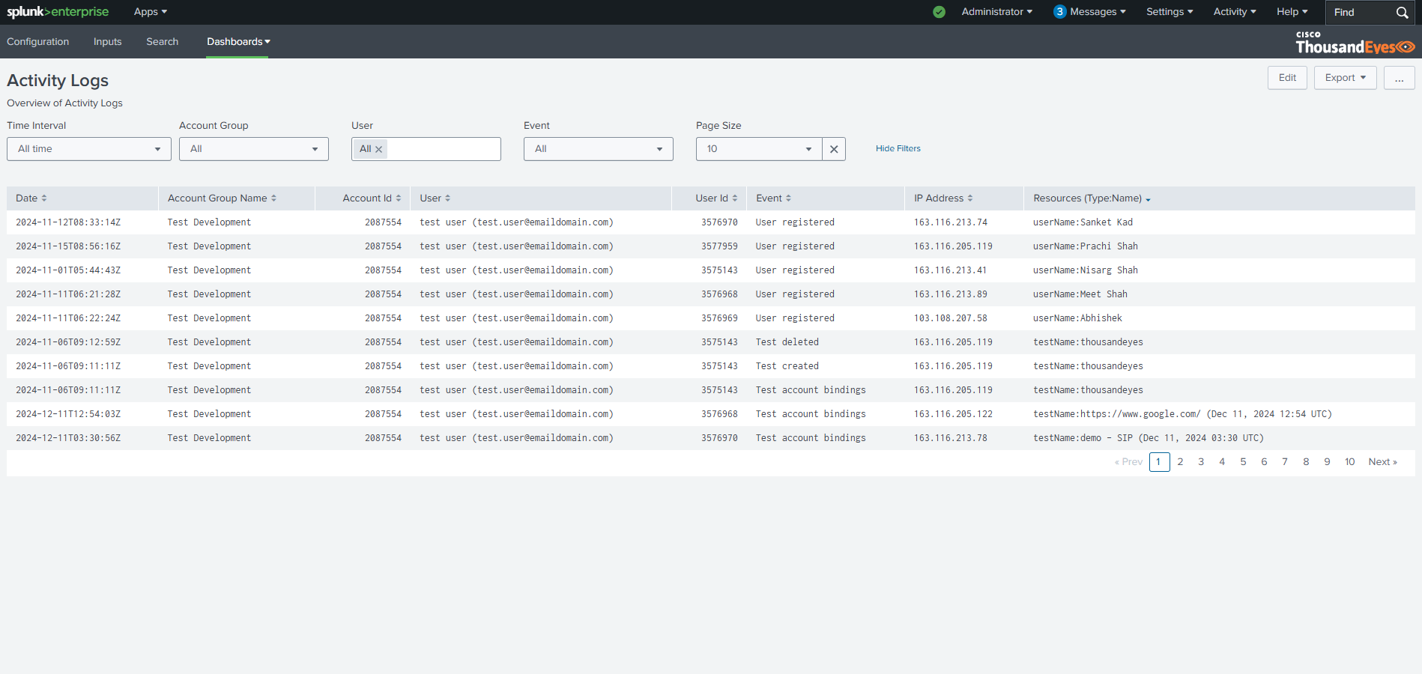
Step 5. Activity logs dashboards
Notes:
- Todo: screenshot

Slide 34
Recap
OpenTelemetry
Splunk
Goal
Learn to stream ThousandEyes network telemetry data using OpenTelemetry
Verify the ability to stream data to Splunk Observability Cloud and Splunk Enterprise
Detect outages​ instantly with​ ThousandEyes

Slide 35

Complete Your Session Evaluations
Complete a minimum of 4 session surveys and the Overall Event Survey to be entered in a drawing to win 1 of 5 full conference passes to Cisco Live 2026.
Earn 100 points per survey completed and compete on the Cisco Live Challenge leaderboard.
Level up and earn exclusive prizes!
Complete your surveys in the Cisco Live mobile app.

Slide 36




Continue your education
Visit the Cisco Showcase for related demos
Book your one-on-one Meet the Engineer meeting
Attend the interactive education with DevNet, Capture the Flag, and Walk-in Labs
Visit the On-Demand Library for more sessions at www.CiscoLive.com/ on-demand
Contact me at: Insert preferred comms method

Slide 37
Thank you

Slide 38
Cisco

